Slide 1

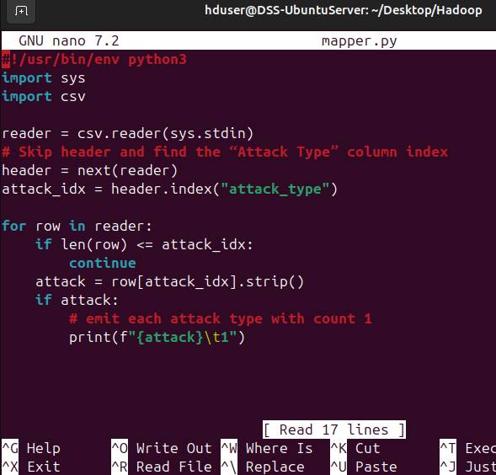
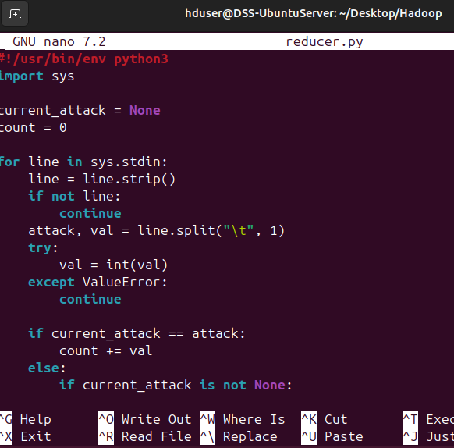
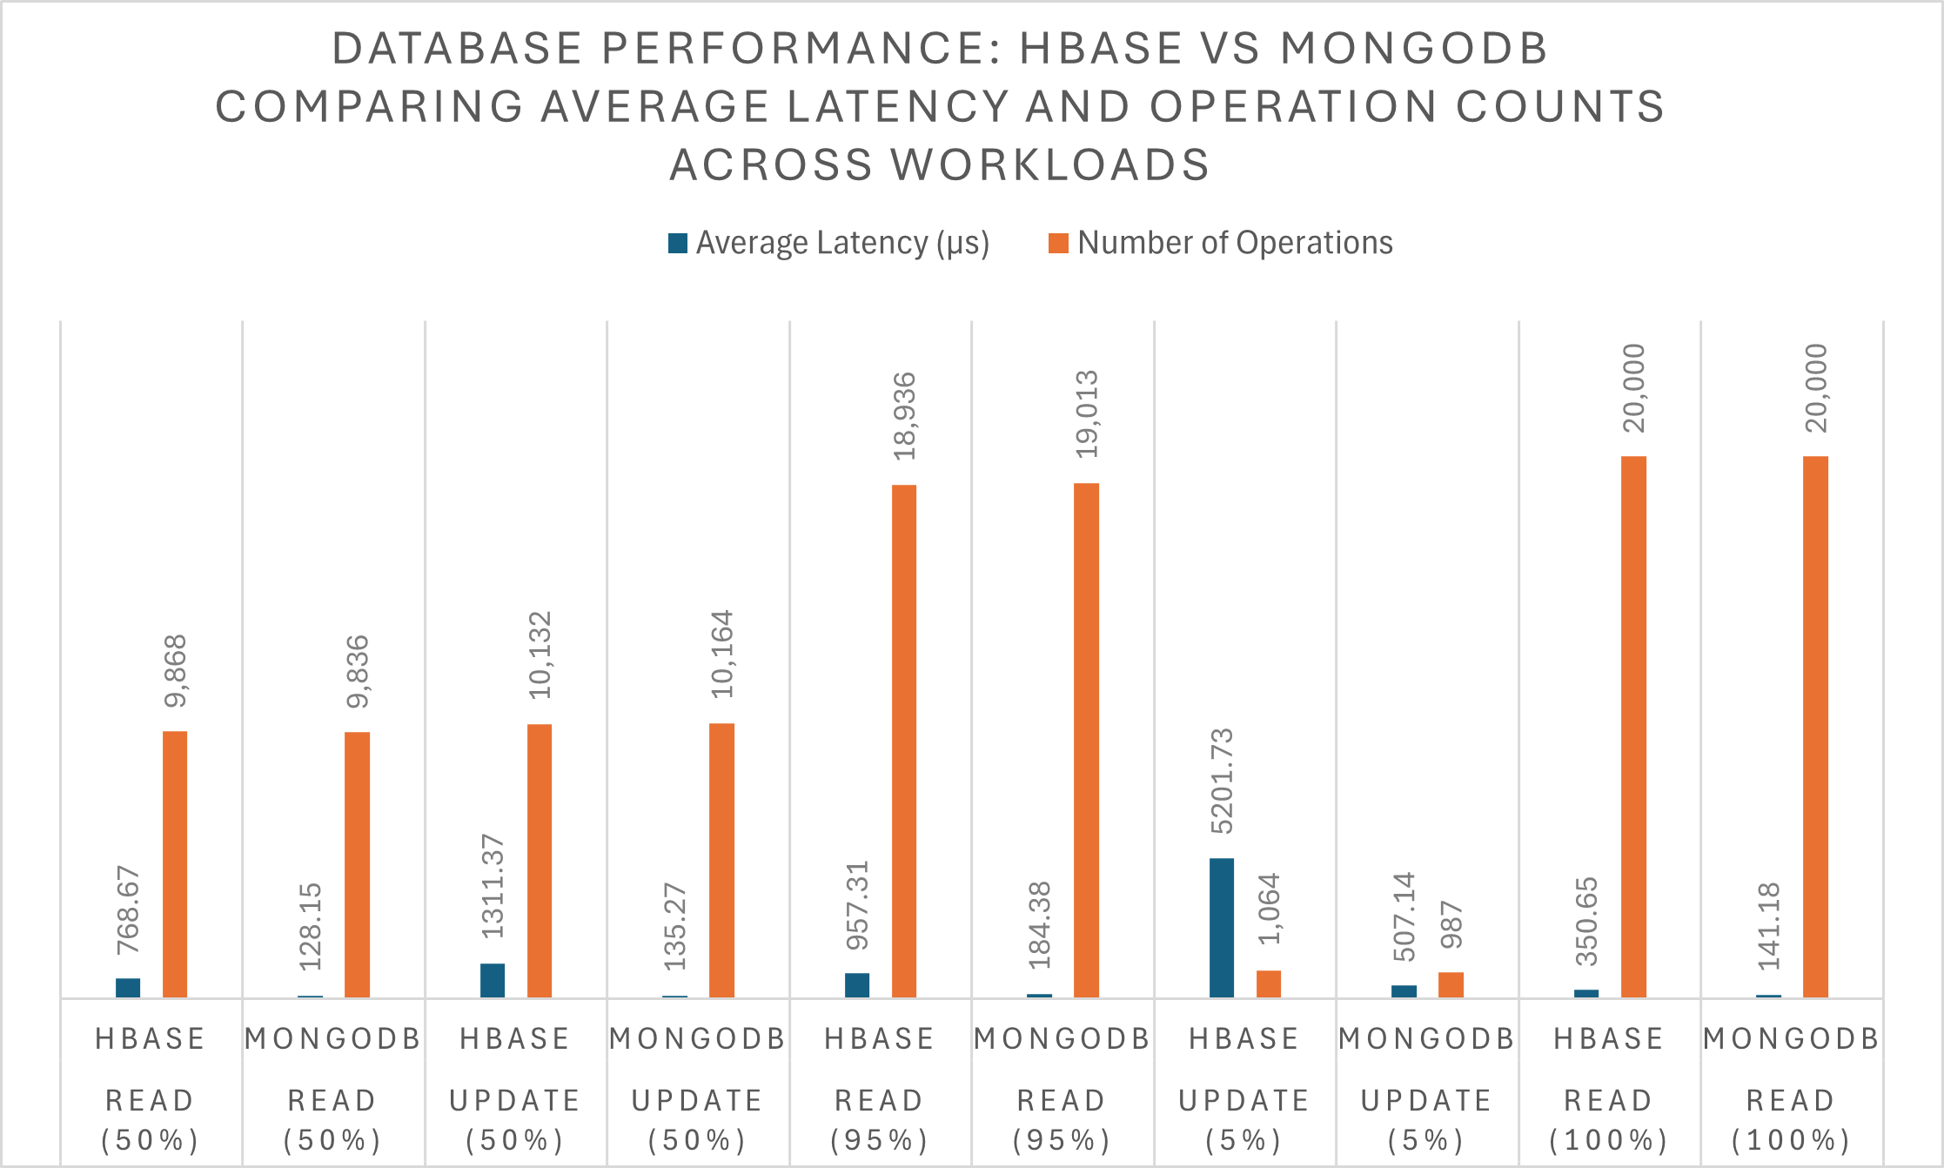

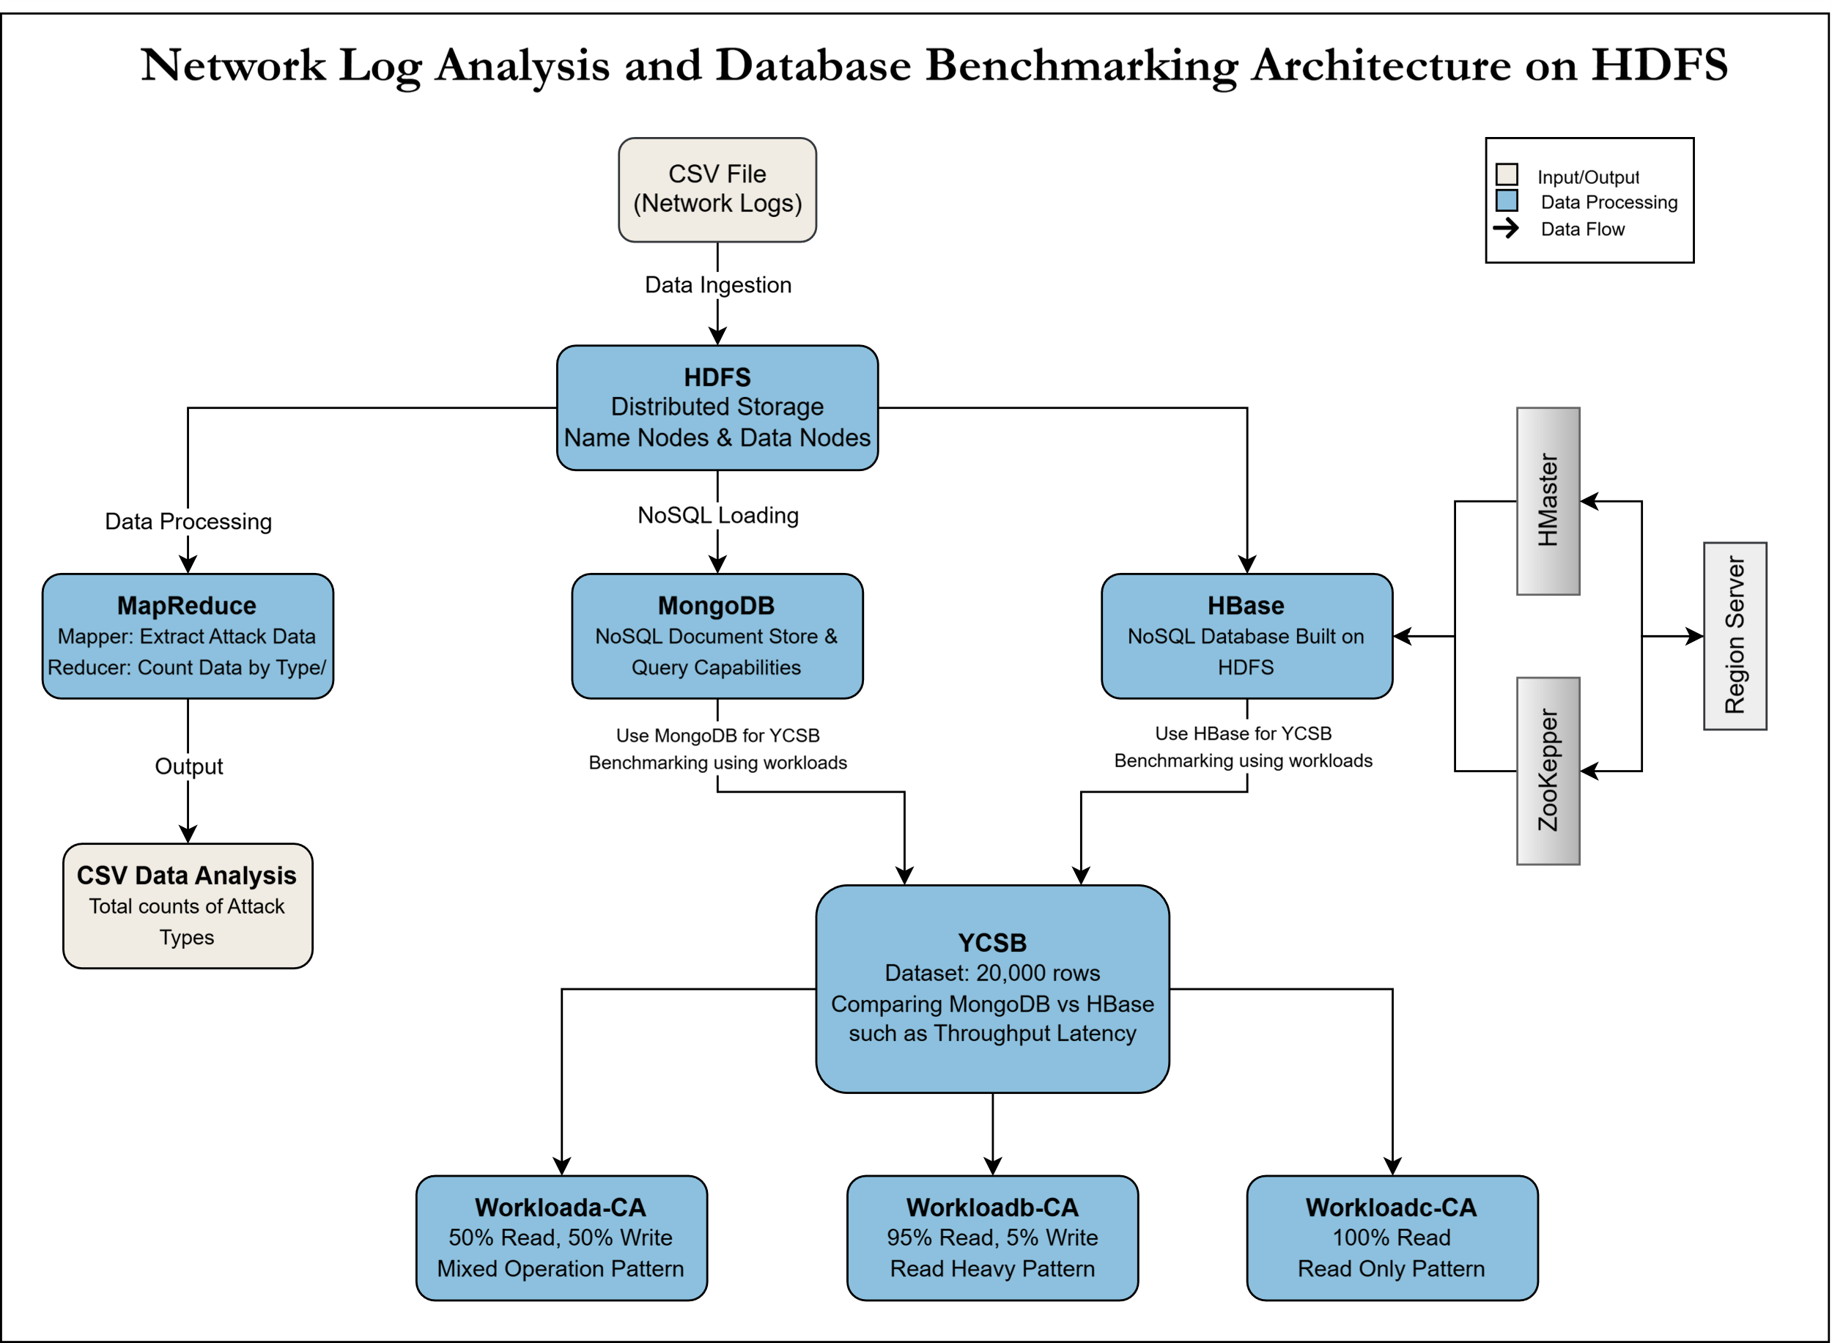
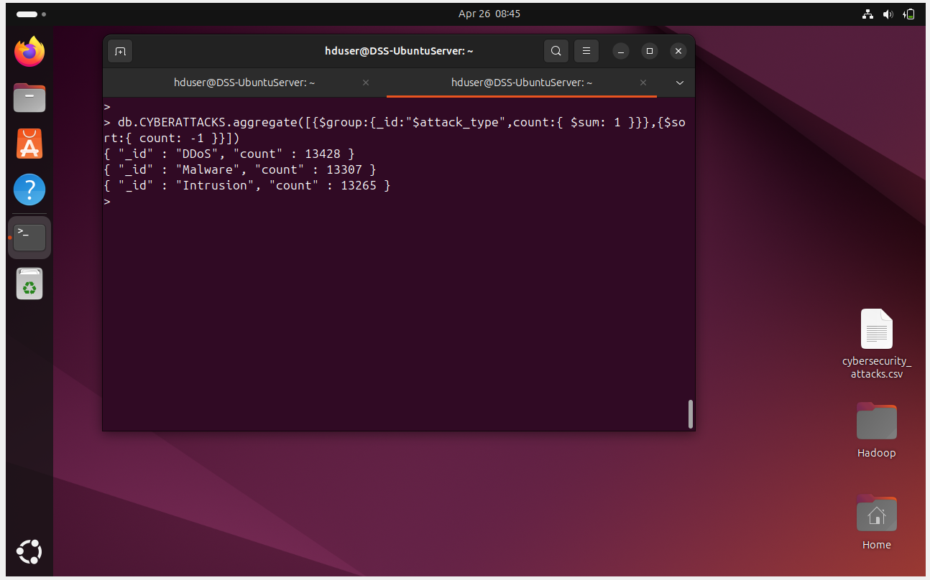
Benchmarking NoSQL Performance in a Hadoop Ecosystem: Scalable Data Storage Solution…
A Critical Analysis By: Ahmed Afzal - 2022552
1. Introduction
3. MapReduce
5. YCSB Comparison
In today's fast-paced digital communication landscape, analysing network traffic logs is essential for identifying security threats and maintaining operational resilience. This project uses a 40,000 rows dataset of network flow records from Kaggle, which includes timestamps, IP addresses, protocol types, packet lengths, and security indicators. The semi-structured nature of this data pose challenges for traditional databases.
To tackle these issues, I suggest a hybrid storage and processing framework that combines the Hadoop Distributed File System for scalable storage with a NoSQL database (HBase or MongoDB) for quick query access. This approach allows for the ingestion of CSV data into HDFS and selective loading into a NoSQL store.
I employ MapReduce technology available within the Hadoop ecosystem. I create a Python script in mapper.py and reducer.py, which I execute to determine the various types of cyber attacks and their frequencies.
In this section, I compared the two NoSQL databases using the industry-standard tool YCSB, focusing on the same three different workload names are:
Workloada-CA (50% Read, 50% Write).
Workloadb-CA (95% Read, 5% Write).
Workloadc-CA (100% Read).
2. System Architecture
Fig. 2 Mapper.py file
Fig. 3 Reducer.py file
Presented here is the system architecture diagram that illustrates the entire workflow of the project, showcasing how data is processed at each stage.
Fig. 4 Output of MapReduce
4. MongoDB Queries (NoSQL)
First, upload the data to Hadoop, and then transfer it to the MongoDB database to run NoSQL queries for retrieving Information.
Fig. 6 Chart of a Workloads Comparison
6. Conclusion
This project focused on importing a semi structured dataset of 40,000 network log entries into HDFS and MongoDB, using MapReduce for attack type aggregation and YCSB benchmarks with 20,000 records across three workloads. The architecture allowed for scalable storage and efficient queries. Results showed MongoDB performed better in read-heavy situations, while HBase handled balanced loads more effectively.
References
CloudDuggu (2023). BigData & Cloud Computing Tutorials | CloudDuggu. [online] Cloudduggu.com. Available at: https://www.cloudduggu.com/
[Accessed 26 Apr. 2025].
Kaggle (n.d.). Cyber Security Attacks. [online] www.kaggle.com. Available at: https://www.kaggle.com/datasets/teamincribo/cyber-security-attacks
[Accessed 22 Apr. 2025].
Fig. 1 Hadoop Distributes System Architecture Diagram created by Ahmed Azal on Draw.io.
Fig. 5 Query on MongoDB Shell

